Slide 1
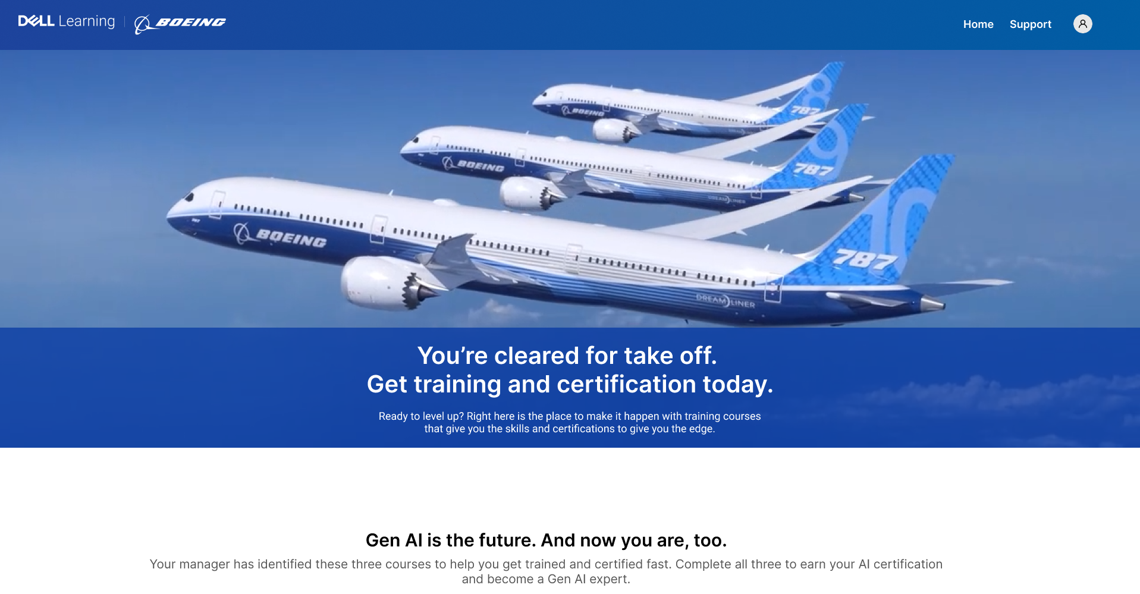
Home Page

Slide 2
Top Header with Dell Learning and Boeing Logo
Home Link
Support Link
Login icon

Slide 3

Video Carousal Component with Text
Video carousal Component build
Videos
Text

Slide 4

Text Component
Existing component
Text

Slide 5

Generic Component
Icon
Text
Link to the course landing page

Slide 6
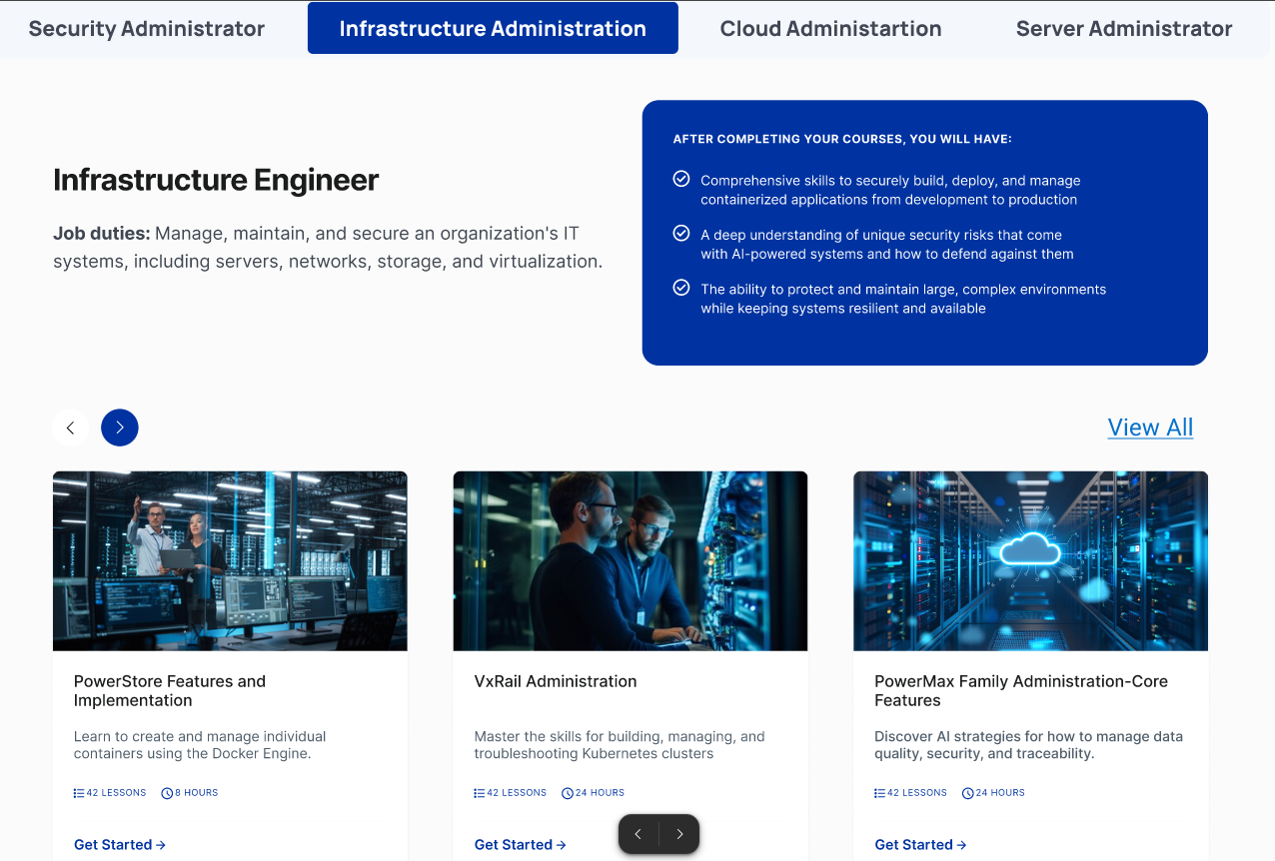
Tab component
Text component
Tab component with each tab containing
Course Details card
Lesson details
Hours
Link to course landing page

Slide 7
Footer
Dell learning and Boeing Logo images
Linked
Pages for the links

Slide 8
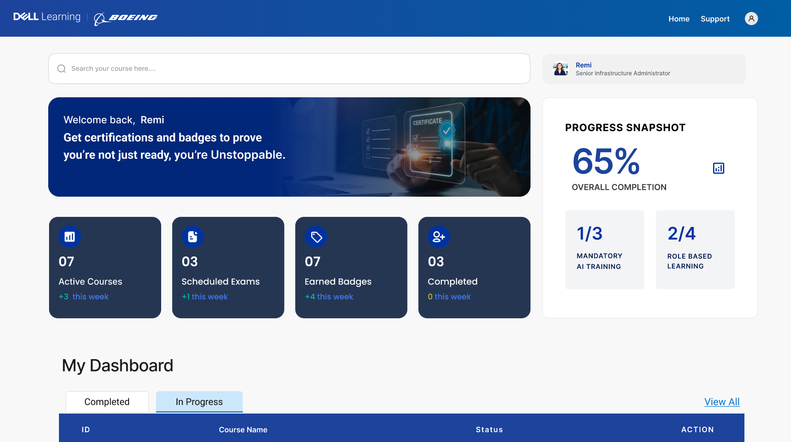
Dashboard

Slide 9
Search Component – existing
Need to modify the CSS for the rounded edges

Slide 10

User profile Display with rounded edge light background
Image- Avatar
Name
Title
Data source from Boeing

Slide 11

Text Component
Dynamic “name” field
Background image with rounded edge
Text to display

Slide 12
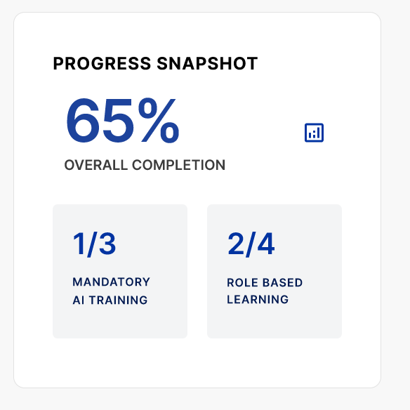
Card Component with dynamic data
Small completion icon
Round edge border - CSS
Completion status with overall completion calculations
Mandatory training count completed vs Assigned
Role based training count completed vs Assigned

Slide 13
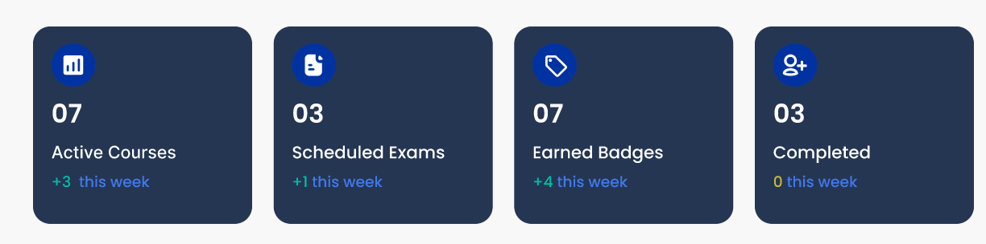
Card Components with Rounded edge background and small Icons
Active Courses – Total # from LMS, Comparison # from the last week
Completed Courses – Total # from LMS, Comparison # from the last week
Scheduled Exams – Total # from the Alpine data, Comparison # from the last week
Earned Badges – Total badges# from Alpine data, Comparison # from the last week

Slide 14
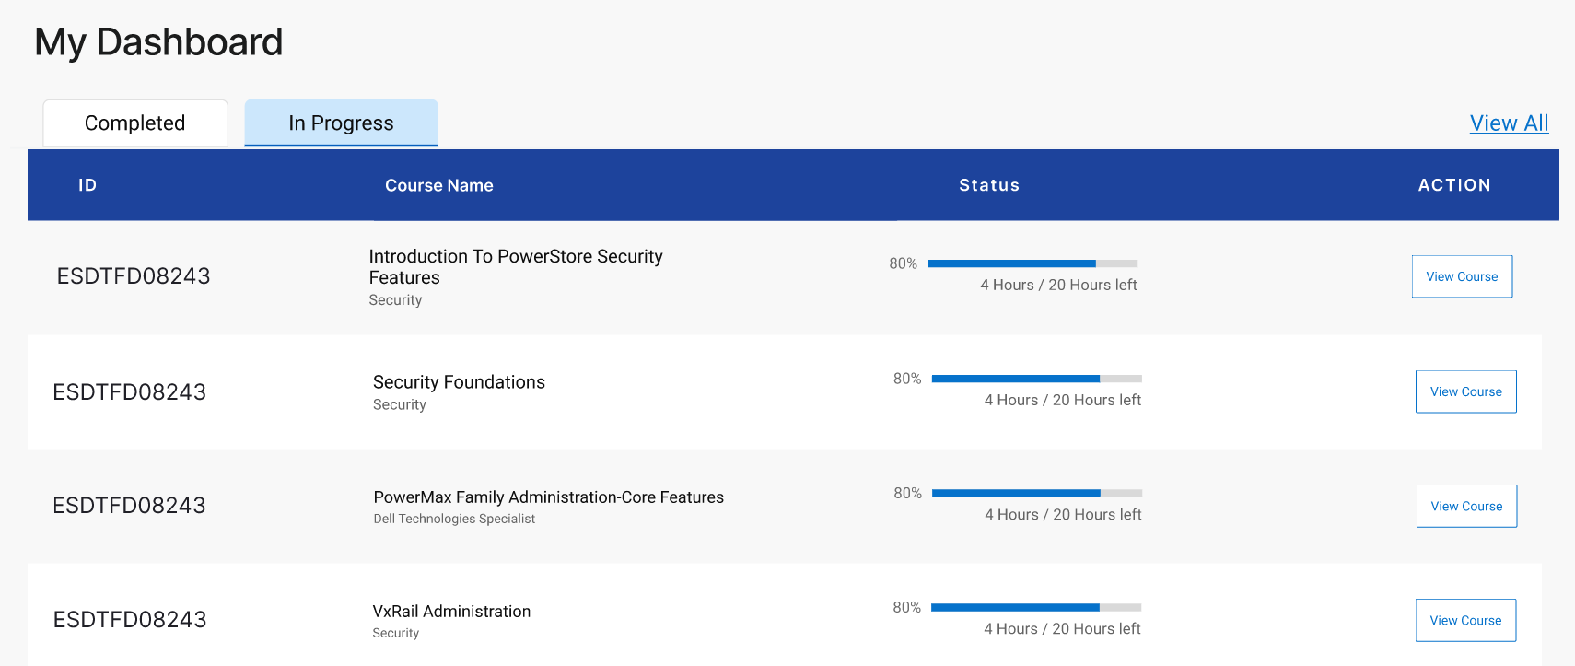
My Dashboard
Tab component
View all Link
In Progress Course Tab
Course ID, Course Name, Domain Name, % completion, # hours left over total numbers, Course landing page link/button
Completed Course Tab
Course ID, Course Name, Domain Name, Completion status, Course landing page link/button

Slide 15
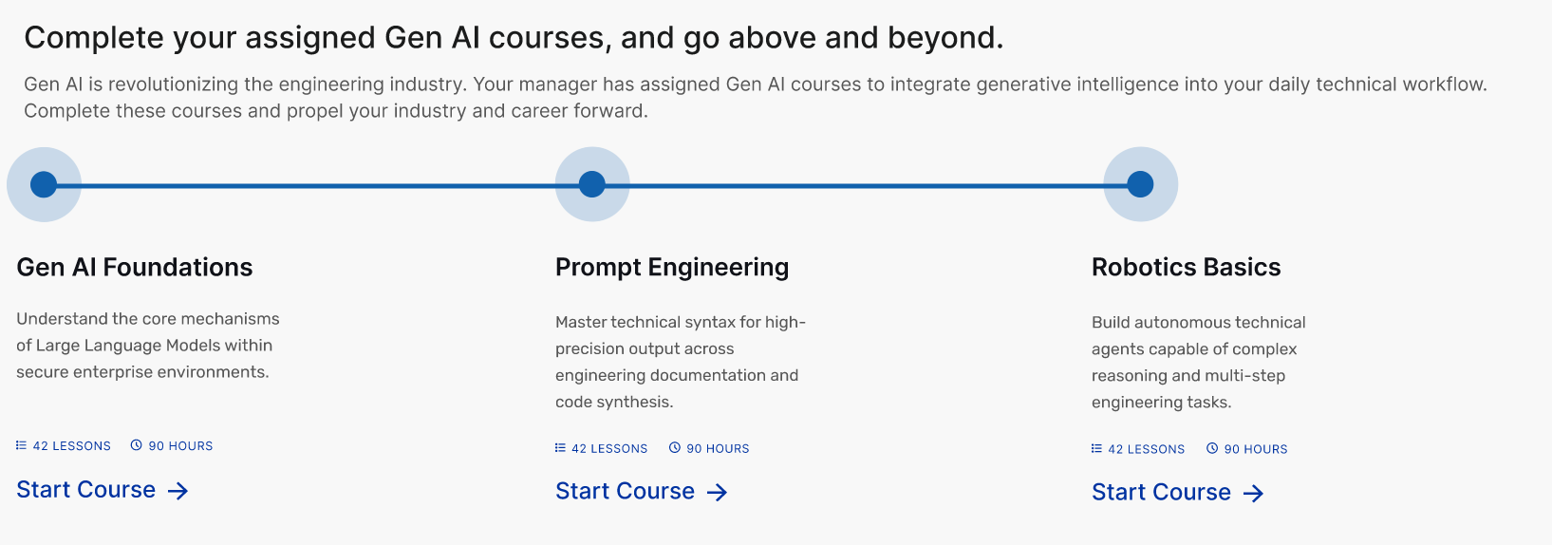
Learning path image and text Card
Course name and Brief summary
Dynamic component- Lessons and # of hours
Course landing page link

Slide 16

My Certification card component
Card image – rounded edge
Text
Link to Certification page (External?)

Slide 17
Resume current Module
Dynamic component
Name of the latest course in-progress
Brief Overview
Continue button – link to the course launch page
Progress bar with progress %

Slide 18

Assigned Learning path/package - Card Component with Dynamic data
Learning path/package Details- Name, Total Duration, # of courses
Brief overview
Link for the learning path/package landing page

